Slide 1
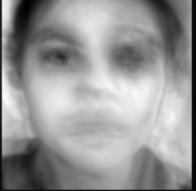
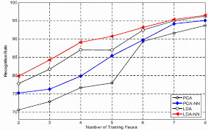
Real Time Facial Recognition Using Principal Component Analysis (PCA)
By: Vinay Krishnan and Shawn Nazarloo
Advising Teacher: Mr. Sturges
Topic: Computer Science & Machine Learning
Mentor: Britton Finley
Notes:
My name is Vinay Krishnan
My partner……
Our project is Real Time Facial Recognition using Principal Component Analysis Also Known as PCA
Our Project Mentor is Britton Finley
Our Advising Teacher is Mr. Sturges

Slide 2
Abstract:
Facial recognition as a biometric for security identification is becoming an increasingly utilized tool in the real world. In this research project we asked if creating a unique identifier using principal component analysis (PCA) for facial recognition could be a method to accurately identify faces. A computer programing language called Python was used to generate the unique numerical identifier for facial images. Utilizing this code a series of data were generated for features on the facial image. PCA was used to integrate the data to generate the unique numerical identifier for each facial image. The Python program allowed us to generate a dataset of facial images that were stored in a Trained memory. We then also looked at the accuracy of image retrieval from a Trained data set. The validity of the method used to generate a unique number array for each face image was confirmed. The accuracy of retrieval varied from 50% to 97% accuracy. The programing at this stage of development was not sophisticated enough to allow for variations in image quality, lighting conditions or changes in facial features over time. Some of these conditions may have contributed to the low accuracy retrieval for one of the facial images scanned. In conclusion, we were able to successfully program and utilize PCA to generate a unique identifier number array for each subject imaged. In four of the five images we were able to have a 83% to 97% accuracy in retrieving the right image. This methodology of using PCA for unique identification of facial images could be used in future security applications such as in law enforcement, in school security systems and other real world applications.

Slide 3
Research Question and Hypothesis:
Research Question:
How can we create a unique numerical facial identifier using principal component analysis (PCA)?
Hypothesis:
IF PCA is a valid method for Facial Recognition, THEN our program will be able to recognize an identity based off of a known training set.
Notes:
Shawn

Slide 4
Purpose:
We have had an interest in learning computer coding languages, videogaming technology and learning how to use these skills on practical based applications.
Using these newly acquired skills, we thought about how we could use it to create an application that could be innovative and futuristic.
With the new iPhone being released recently that uses facial recognition to identify the owner, to unlock the phone, we were inspired by this new application on an iPhone to consider ways to improve on that technology.
In researching the facial recognition topic we were amazed at how many different ways facial recognition technology is used in day to day lives of people. For example, tagging friends in social networks like Facebook and google, security technologies that are used to identify criminals during mass shootings in public places, or trying to keep our schools safe from unintended trespassers were some of the ways facial recognition technology are being used today.
Although we recognize that we are early learners of computer coding, we attempted to create a program using python and a mathematical concept called principal component analysis (PCA) to develop a simple Facial Recognition algorithm to test if our program worked on recognizing faces that were acquired, stored, and retrieved. and with what percent accuracy did this retrieval occur at.
Notes:
Shawn

Slide 5
Materials Used:
Computer with High Definition Camera
ACER – ASPIRE F15 with HD Webcam
Python programming language
https://pythonprogramming.net/
Volunteers to acquire facial images
Project partner, parents, friends
Experimental Variables:
Independent Variable:
Numerical identifiers with every single input image
The shape of the face at run time
The lighting conditions in the environment
The orientation of the face can change
Skin shade or skin color
Facial hair or hair style
Objects on face such as glasses, nose rings, eyebrow rings, hats, makeup, etc.
Head position or face tilt
Dependent Variable:
The environmental changes that impacts the facial image over time
Constant and Control Variable:
The training set of the unique images
The individual image of the human being remains constant for the particular experiment
Notes:
Skip

Slide 6
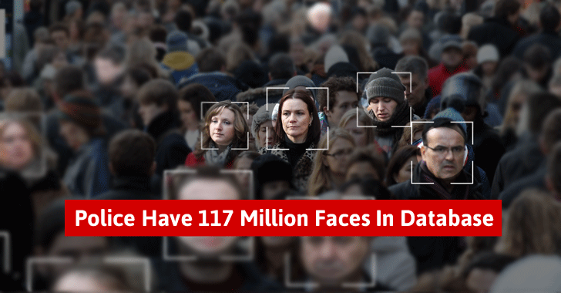
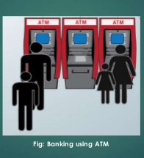
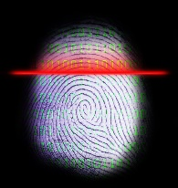
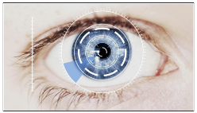
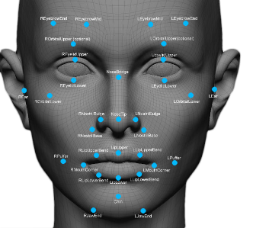

Background:
What is Facial Recognition?
Facial recognition is a biometric method of identifying or recognizing an individual’s face through a digital image [Rouse].
Why use Facial Recognition Technology?
Facial Recognition Technology can be used in many aspects of daily living:
In law enforcement as a crime fighting tool
Employee identification tool in offices and companies
Student, administrators and parent identification in schools for security purposes
Credit card security tool and fraud prevention
Finding missing people from surveillance
Types of biometric recognition technology that can used:
Fingerprint/hand recognition
Iris scans
Speech recognition
Facial recognition
Notes:
Shawn

Slide 7
Background:
How does Facial Recognition Work?
Facial recognition tools can be used to recognize a face and then measure the various features of the face and store it as a unique numerical identifier
First, a digital camera is used to capture an image of a face
Next, we extract a unique numerical identifier for the particular image.
The software analyzes the facial features and the data is stored as a unique identifier for that person based on the trained facial identifiers.
The input data is then compared to trained data that exists in memory and the software creates a score to match the face to what already has been trained.
Depending on how well the score matches the person is identified as a positive match or not.
Capture
Extract
Compare
Match/
Non Match
Accept/
Reject
http://www.techguruit.com/top-8-ways-facial-recognition-software-used-today/
Notes:
http://www.techguruit.com/top-8-ways-facial-recognition-software-used-today/
I am going to explain to you how our facial recognition program works.
First we Capture training faces with a webcam
We then Extract unique facial information to store in memory
Then the program Compares input face with known training set that was previously run through the program
The program then Matches the input face with the closest known face in the training set
The program then Accepts or Rejects depending on If there is a match

Slide 8
Experimental Procedure:
Step 1: Learnt how to code in Python
https://pythonprogramming.net/
Step 2: Wrote code using Python language for recognizing faces
Imported an OpenCV library to access the web camera on the computer to the code
Set up 2 hard cascade files to code recognition of the frontal face and eyes
Set up a code to create an outline of a box as the boundary for the individual faces that were going to be imaged
Coded functions that would obtain the a. trained data b. generate the facial image c. recognize the face d. exit the program
Step 3: Volunteers were asked to acquire their facial image via the HD Webcam on the ACER computer. The person has to remove their glasses and move forward and backward until the image is captured within the black box.
Step 4: Using the code obtained a training set of images that could acquired at a future date
Notes:
Skip

Slide 9
Research:
What is Principle Component Analysis?
Principle Component Analysis (PCA) is a technique that uses underlying variables (known as principal components) to best differentiate your data points [Chakraborty et.al.2012, Dallas 2015 and Hariharan et. Al, 2013].
Application of Principle Component Analysis:
Principal Component Analysis (PCA) is used as a data analytics tool to help visualize large datasets.
It can be used for image recognition when large datasets are generated and compress the data that can be more manageably viewed and analyzed. Two methods to compress data can be:
Noise reduction - a process that helps remove noise from a particular signal. All recording devices, both digital and analog, have traits susceptible to noise.
Dimensionality Reduction – a process that take high dimensional datasets (data that can not be seen by the naked eye) and converts them into low dimensional datasets (a more manageable dataset) by reducing the amount of data points in the input images of our facial recognition program.
Generating Image Vectors- process that is used in Dimensionality Reduction
N x N image
N² X 1 vector
Turk et. al. 1991
Notes:
I am going to Explain what Principal Component Analysis is in simple terms
It is a Technique that is used to find patterns in large data sets
In our project the Patterns are the FACES
Recognition is the process of finding and comparing the UNIQUE pattern
Another concept used in our project is Dimensionality Reduction.
Dimensionality Reduction is a method to reduce a large number of data points to a smaller set that still contains all of the important information of the set

Slide 10
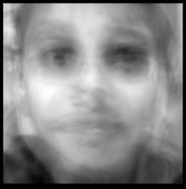
Graphical Representation of the Algorithm
Input Images
N x N image
Code for acquiring the images for the Training dataset
I.
N² X 1 vector
“Vectorize”
(1)
(2)
(3)
(K-1)
(K)
N² x K
Concatenate
Subtract the mean face value
II.
=
A – Mean Vector
“K ” Input Training Faces
III.
K x N²
X
N² x K
=
K x K
Generate the Covariance Matrix
(A^{T} X A)
Covariance
Matrix
(K- Components)
Application of Eigen Decomposition
K x K
Eigen
sort
K x K
IV.
Decomposition
N² x K
K x K
=
N x N
Generate unique numerical identifiers
V.
N² X 1
(A X Covariance)
Eigen Face
Eigen Faces
Eigen Faces
Notes:
This is a graphical representation of the algorithm
Following slides is the Python code for the facial recognition program
We first
I: Convert images into “computer” readable version of that image – this is called Code for acquiring the images
II. Compile image vectors into common set and subtract shared data (leaving images with only their unique data points) – this is called the Subtract mean face value
III. Generate reduced version of the training data while retaining all important information of the set – this is the generate the covariance matrix step – which is the dimensionality reduction
IV. Finding the unique points of the REDUCED dataset – from the dimensionality reduction we find the eigen decomposition which leads to the final step of getting the
V. “Eigenface” is the output set of unique numerical identifiers which is what is on the next slide

Slide 11

Results: Python Code for Facial Recognition
Code for acquiring the Training dataset
Subtract the mean face value
Generate the Covariance Matrix
Application of Eigen Decomposition
Generate unique numerical identifiers
Facial Recognition Program Structure
Notes:
Python Code for Facial Recognition

Slide 12

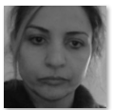
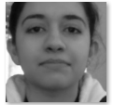
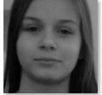

Results and Analysis/Outputs:
Subjects: | Average Accuracy: | Image: | Average Match Confidence % :
Hossien Nazarloo | 1st Trial- 2/10 2nd Trial- 3/10 3rd Trial- 10/10 Average: 50% Accuracy |  | 76.8%
Leila Partoo | 1st Trial- 10/10 2nd Trial- 10/10 3rd Trial- 10/10 Average: 100% Accuracy |  | 83.7%
Parmida Nazarloo | 1st Trial- 9/10 2nd Trial- 10/10 3rd Trial- 10/10 Average: 97% Accuracy |  | 74.4%
Mallory Bell | 1st Trial- 5/10 2nd Trial- 10/10 3rd Trial- 10/10 Average: 83% Accuracy |  | 67.4%
Britton Finley | 1st Trial- 9/10 2nd Trial- 10/10 3rd Trial- 10/10 Average: 97% Accuracy |  | 73.6%
Average Accuracy = success of the program getting the correct unique identifier
Average Match Confidence = is the confidence with which the program assigns an identity to that image
Notes:
Shown here are the Data results from volunteers. We had 5 subjects that volunteered
The 1st column of numbers is the Accuracy: Accuracy when matched to the trained data set. So when the image was scanned how accurately was the program able to pull the image from the Trained data set.
The 2nd column is the Average Match Confidence: it is the Algorithm’s confidence that the match is accurate
To improve Accuracy: we would need to Increase number of data points for a subject in varied conditions → MORE DATA!
To improve Confidence: we need to Improve quality of data points → BETTER DATA! E.g. lighting conditions, higher resolution camera etc.

Slide 13
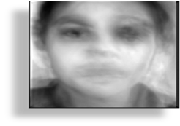
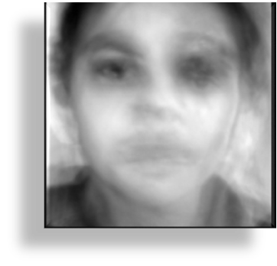
Results and Analysis/Outputs:
Subjects: | Average Accuracy: | Image: | Average Match Confidence % :
Mr. Sturges | 1st Trial- 10/10 2nd Trail 10/10 3rd Trial- 10/10 Average: 100% Accuracy |  | 72.3%
Gary Krishnan | 1st Trial- 10/10 2nd Trial- 10/10 3rd Trial- 10/10 Average: 100% Accuracy |  | 70.0%
Vinay Krishnan | 1st Trial- 8/10 2nd Trial- 10/10 3rd Trial- 10/10 Average: 93% Accuracy |  | 80.4%
Shawn Nazarloo | 1st Trial- 10/10 2nd Trial- 9/10 3rd Trial- 10/10 Average: 96% Accuracy |  | 76.5%
Priya Krishnan | 1st Trial- 10/10 2nd Trial- 8/10 3rd Trial- 9/10 Average: 90% Accuracy |  | 63.4%
Average Accuracy = success of the program getting the correct unique identifier
Average Match Confidence = is the confidence with which the program assigns an identity to that image
Notes:
Shown here are the Data results from volunteers. We had 5 subjects that volunteered
The 1st column of numbers is the Accuracy: Accuracy when matched to the trained data set. So when the image was scanned how accurately was the program able to pull the image from the Trained data set.
The 2nd column is the Average Match Confidence: it is the Algorithm’s confidence that the match is accurate
To improve Accuracy: we would need to Increase number of data points for a subject in varied conditions → MORE DATA!
To improve Confidence: we need to Improve quality of data points → BETTER DATA! E.g. lighting conditions, higher resolution camera etc.

Slide 14
Discussion/Conclusion:
In this Toshiba project we used python programming and the use of principal component analysis to create a unique numerical identifier to detect a specific facial image. Our hypothesis was if PCA was a valid method for Facial Recognition, then our program will be able to recognize an identity based off of a known training set. We successfully developed the program and a unique numerical identifier for the faces we imaged. These images were successfully stored in the Trained data set. We then re-imaged the same faces to determine if the faces could be recognized using the already stored data in the Trained data set. We then determined the percent accuracy for the image retrieval. We successfully imaged five faces and generated five unique numerical identifiers. To test for accuracy the individuals were re-imaged 3 times to determine if the face was retrievable. Our results show our accuracy was in the range of 50%-97% to identify the correct person given the image. Although one image had a very low (50%) accuracy rate for image retrieval, we believe we were successful in implementing our hypothesis, as we were able to program and obtain a unique numerical identifier for an imaged face and we were able to in most cases identify the correct person with high accuracy (83%-97%). The one outlier in the image retrieval could have been due to low lighting conditions and other background conditions at the time of re-imaging. The program we used did not use complex programming that would allow variables like different light conditions, background conditions and facial feature changes.
Notes:
In conclusion we were successful at proving our hypothesis which was if PCA – principal component analysis was a valid method for facial recognition, then our program would be able to recognize a facial image and retrieve it from a trained data set.
Hypothesis WAS SUPPORTED with our experimental results
We successfully retrieved images from 5 volunteers. The Accuracy of retrieval from the trained data set was in general higher than the Confidence level of retrieving. We believe this difference is most likely because the environmental conditions varied and if we had consistency in lighting and image quality then we likely would have seen higher confidence matches.

Slide 15


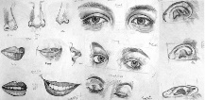
Future Direction:
Future of Biometric Facial Recognition Project:
In the future, we will try to bring Facial Recognition to a faster and more secure state by improving the code.
We would also like to pair facial recognition technology with other types of recognition system’s, like Iris Scanners, Speech Recognition, and Finger Print Scanners. This would likely improve the accuracy and predictability of the software.
Finally, in the future we would like to apply our system into a software that allows everyday people to use it. We would like to improve our system and fine tune it to make it publicly usable for people all around the world. Big companies and security firms could also use it in their facilities to improve the ease of use, reliability and the security of their systems.
In the next five years, facial recognition will have gained lots of attraction. In the next ten years, facial recognition will be used for common consumer products. In the next fifteen years, facial recognition will be much faster and easier to use. In the next twenty years, facial recognition technology will be given to others in need of more advanced systems.
Imperfection of the Project:
We also believe that we had flaws with our project. Some factors that could impact accuracy in recognition and retrieval of the images are proper lighting, environment/background effects, and facial changes over time.
We did not incorporate these aspects of the environment, lighting, and facial changes into the code we wrote, and therefore our code is likely not going to pick up on facial features that are impacted by these conditions.
Imperfections
Lighting
Habitat
Features

Slide 16
References:
Chakraborty, Dulal. “Http://Research.ijcaonline.org/volume50/number10/pxc3880947.Pdf.”Face
Recognition Using Eigenvector and Principle Component Analysis, vol. 50, July 2012, pp.
42–50., doi:International Journal of Computer Applications.
Dallas, George. “Principal Component Analysis 4 Dummies: Eigenvectors, Eigenvalues and Dimension Reduction.” Https://Georgemdallas.wordpress.com/2013/10/30/Principal-Component-Analysis-4-Dummies-Eigenvectors-Eigenvalues- and-Dimension-Reduction/, 27 Jan. 2015, georgemdallas.wordpress.com/2013/10/30/principal-component-analysis-4-dummies- eigenvectors-eigenvalues-and-dimension-reduction/.
Hariharan, Bharath. “How Are Eigenvectors and Eigenvalues Used in Image Processing?” Quora, 4 Feb. 2013,
www.quora.com/How-are-Eigenvectors-and-Eigenvalues-used-in-image-processing.
“Python Programming Tutorials.” Python Programming Tutorials, pythonprogramming.net/.
Rouse , Margaret. “What Is Facial Recognition? - Definition from WhatIs.com.” WhatIs.com, Tech
Target, whatis.techtarget.com/definition/facial-recognition.
“Top 8 Ways Facial Recognition Software Is Being Used Today.” Tech Guru, LLC, 14 July 2015, www.techguruit.com/top-8-ways-facial- recognition-software-used-today/.
Turk, M. “Http://Vision.jhu.edu/Teaching/vision08/Handouts/case_study_pca1.Pdf.” Eigenfaces for
Face Detection/Recognition, vol. 3, 1991, pp. 1–11., doi:Journal of Cognitive Neuroscience.

